Slide 1
Applied Symbolic Computation
(CS 300)
The Fast Fourier Transform (FFT) and Convolution
Jeremy R. Johnson

Slide 2
Introduction
Objective: To derive the fast Fourier transform (FFT) as a factorization of the Vandermonde matrix. To introduce the convolution operator and relate it to polynomial and matrix algebra. To use the Chinese Remainder Theorem to prove the convolution theorem and rederive the FFT.
  Vandermonde Matrices
  Polynomial multiplication using interpolation
  Factoring the Vandermonde matrix using even/odd symmetry
  Convolution Theorem
  Deriving the FFT using the Chinese Remainder Theorem
References: Lipson, Tolimieri, Cormen et al.

Slide 3
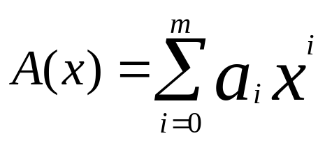
Horner’s Method
Let A(x) = a₃x³ + a₂x² + a₁x + a₀
A(α) = ((a₃ α + a₂) α + a₁) α + a₀
In general, let
A₀ = a_{m}
A_{i} = A_{i-1} α + a_{m-i}
A_{m} = A(α)
The number of operations is 2m (m additions, m multiplications)

Slide 4
Evaluation Utilizing Symmetry
The cost of evaluation at two points can be reduced if one is the negative of the other.
Let A(x) = A₁(x²)x + A₀(x²), where the coefficients of A₁(x) are the odd coefficients of A(x) and the coefficients of A₀(x) are the even coefficients of A(x)
  Since (-α)² = α², A₀(α ²) = A₀(-α ²) and A₁(α ²) = A₁(-α ²)
  A(α) = A₀(α ²) + α A₁(α ²)
  A(-α) = A₀(α ²) - α A₁(α ²)
Example
  A(x) = a₅x⁵ + a₄x⁴ + a₃x³ + a₂x² + a₁x + a₀ = A₁(x²)x + A₀(x²)
  A₀(x) = a₅x² + a₃x + a₁
  A₁(x) = a₄x² + a₂x + a₀

Slide 5
Evaluation Utilizing Symmetry
To evaluate A(x), with deg(A) = m, at ±α, requires
  4m operations using Horner’s method for α and -α
  4(m/2) + 3 = 2m + 3 [approx. half] operations (using ± symmetry)
To evaluate a polynomial of degree N-1 at N=2m points
  2N² + o(N²)
  N² + o(N²)

Slide 6
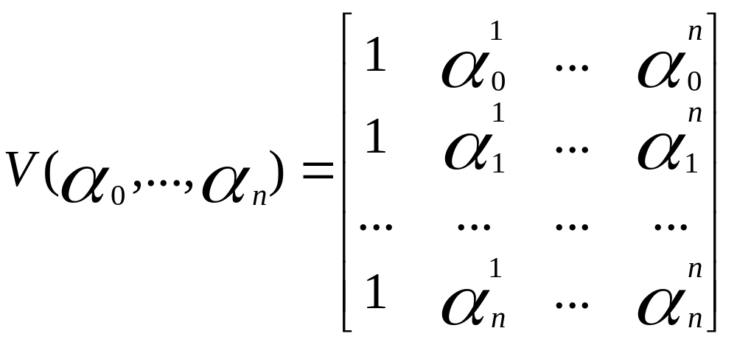
Factoring the Vandermonde Matrix
Recall

Slide 7
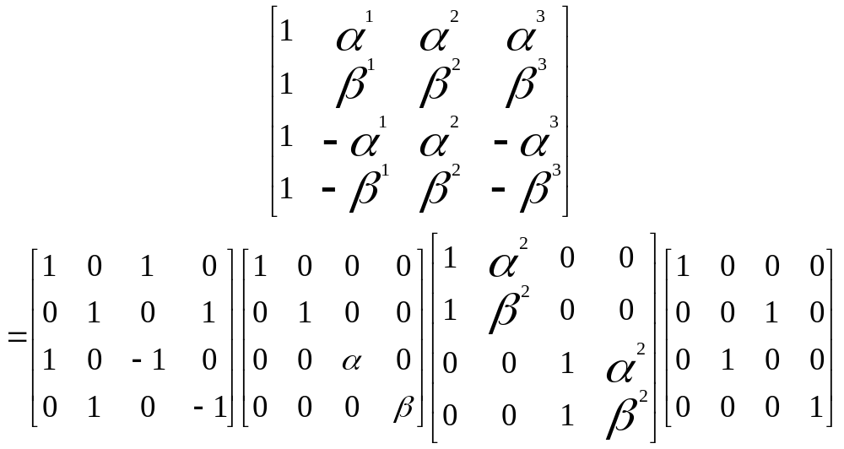
Factoring the Vandermonde Matrix
If n = 2m and α₁,…, α_{n} = α₁,…, α_{m}, -α₁,…, -α_{m}, then the Vandermonde matrix can be factored using the even/odd symmetry discussed previously.

Slide 8
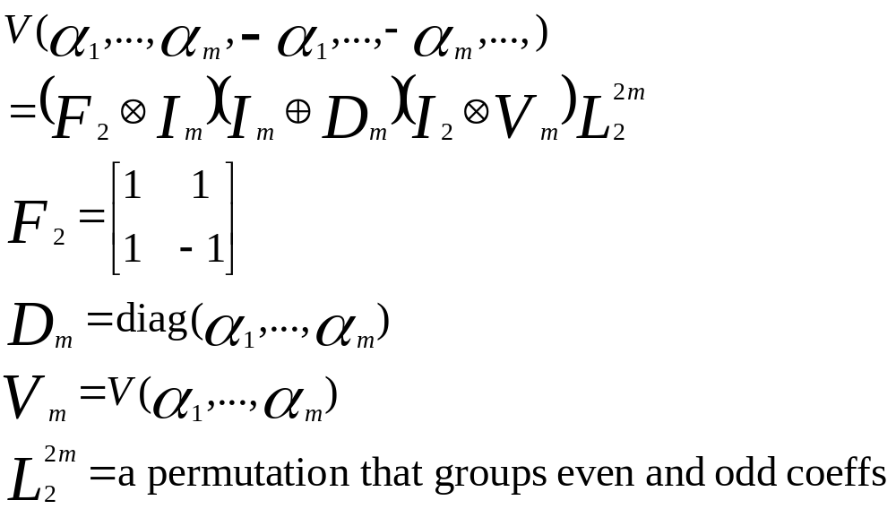
Factoring the Vandermonde Matrix
The previous factorization can be concisely described by the following formula

Slide 9
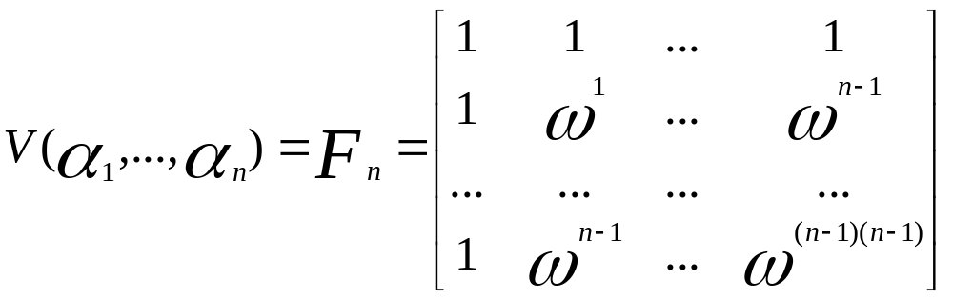
Discrete Fourier Transform
If α₁,…, α_{n} are equal to the nth roots of unity, the Vandermonde matrix becomes the DFT matrix.
Let α_{i} = ω^{i}, where ω is a primitive n^{th} root of unity.

Slide 10
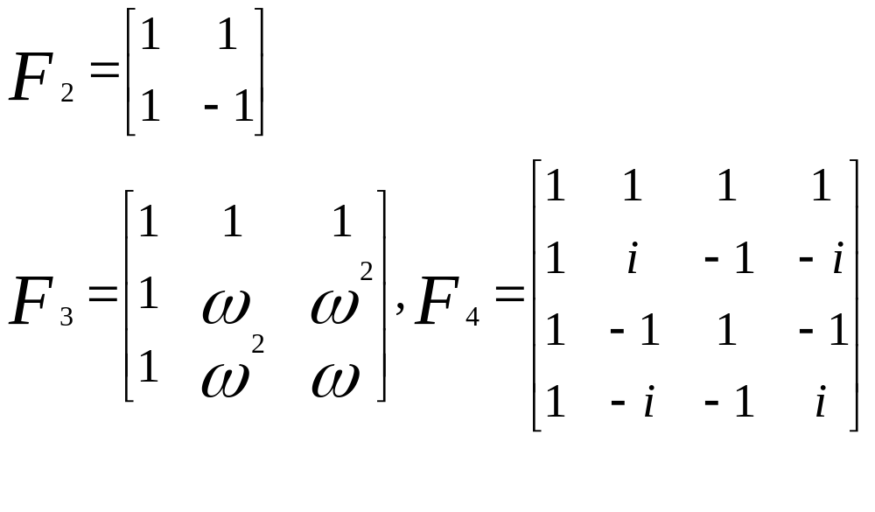
Discrete Fourier Transform

Slide 11
Properties of Roots of Unity
Lemma: ω⁻¹= ϖ.
Lemma: Let n = 2m, and ω be a primitive n^{th} root of unity. Then ω² is a primitive m^{th} root of unity.
Lemma: Let n = 2m, and ω be a primitive n^{th} root of unity. Then ω^{m} = -1 and ω^{m+k} = -ω^{k}.
Therefore, F_{2m} is a Vandermonde matrix where half the points are negatives of the other half. Thus, we can utilize the previous factorization to compute the DFT. Moreover, if n=2^{k} this property can be used recursively.

Slide 12
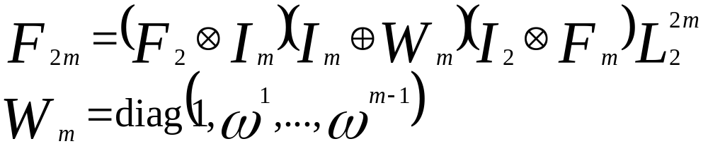
Fast Fourier Transform
Assume that n = 2m, then
Let T(n) be the computing time of the FFT and assume that n=2^{k}, then
  T(n) = 2T(n/2) + Θ(n)
  T(n) = Θ(nlogn)

Slide 13
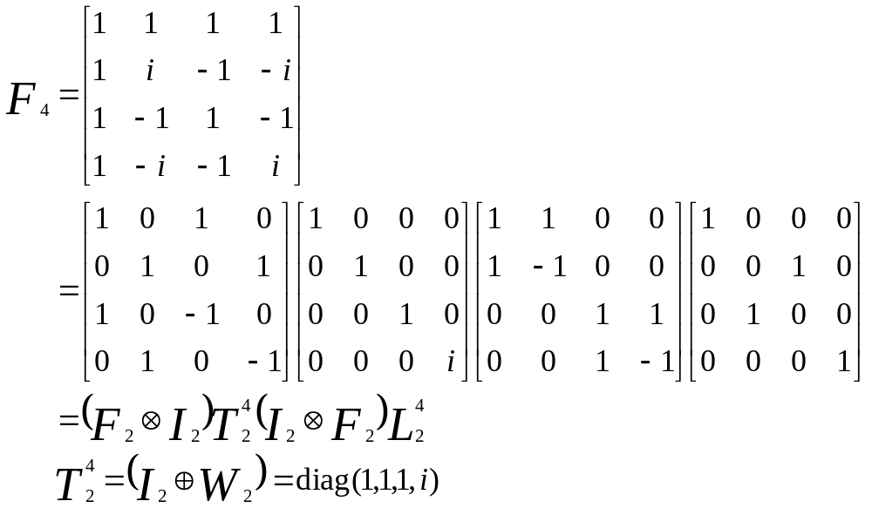
Example FFT Factorization

Slide 14
Polynomial Multiplication using Interpolation
Compute C(x) = A(x)B(x), where degree(A(x)) = m, and degree(B(x)) = n. Degree(C(x)) = m+n, and C(x) is uniquely determined by its value at m+n+1 distinct points.
[Evaluation] Compute A(α_{i}) and B(α_{i}) for distinct α_{i}, i=0,…,m+n.
[Pointwise Product] Compute C(α_{i}) = A(α_{i})*B(α_{i}) for i=0,…,m+n.
[Interpolation] Compute the coefficients of C(x) = c_{n}x^{m+n} + … + c₁x +c₀ from the points C(α_{i}) = A(α_{i})*B(α_{i}) for i=0,…,m+n.

Slide 15
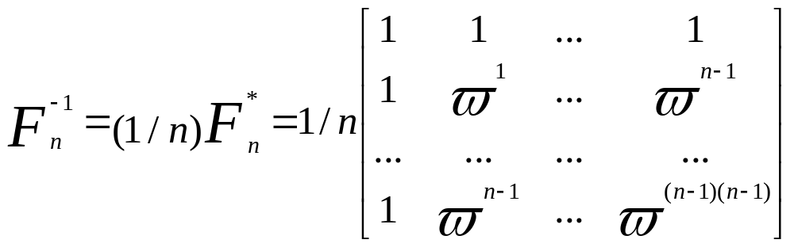
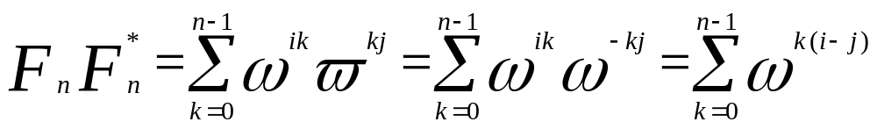
Inverse DFT
Proof: The (i,j) element of
If i = j, then the sum is equal to n, and if i ≠ j, then the sum is 0, since x^{n}-1 = (x-1)(x^{n-1} + … + x + 1)

Slide 16
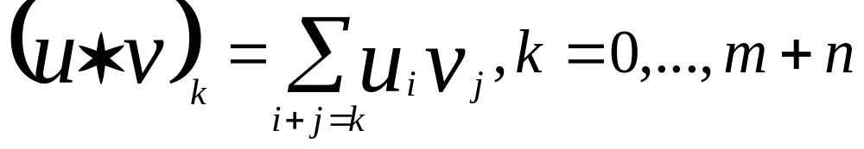
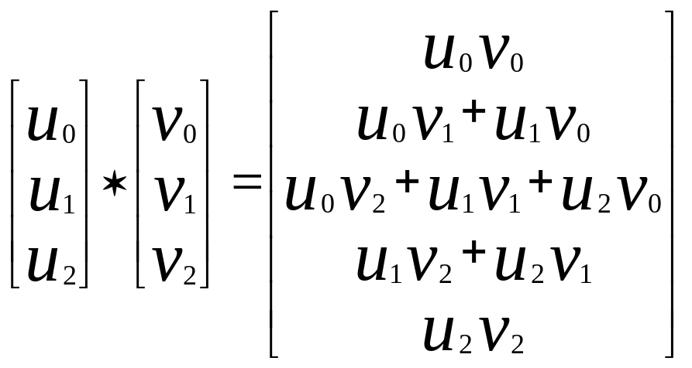
Linear Convolution
Definition: Let u and v be two vectors of size m and n respectively. The linear convolution of u and v is equal to
Example

Slide 17
Linear Convolution and Polynomial Multiplication
Linear convolution is the same as polynomial multiplication
Let u(x) = u_{m}x^{m} + … + u₁x + u₀ and v(x) = v_{n}x^{n} + … + v₁x + v₀ Then u(x)*v(x) = (u*v)_{m+n}x^{m+n} + … + (u*v)₁ x + (u*v)₀
Example
  u(x)v(x) = (u₂x² + u₁x + u₀)(v₂x² + v₁x + v₀)
  = (u₂v₂)x⁴ + (u₁v₂ + u₂v₁)x³ + (u₀v₂ + u₁v₁ + u₂v₀)x² + (u₀v₁ + u₁v₀)x + u₀v₀

Slide 18
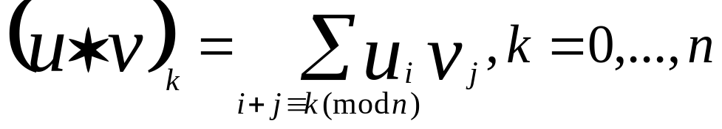
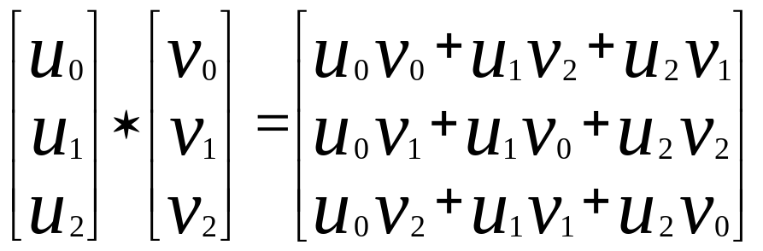
Cyclic Convolution
Definition: Let u and v be two vectors of size n respectively. The n-point cyclic convolution of u and v is equal to
Example

Slide 19
Cyclic Convolution and Polynomial Multiplication
N-point cyclic convolution is the same as polynomial multiplication modulo x^{n}-1.
Let u(x) = u_{m}x^{m} + … + u₁x + u₀ and v(x) = v_{n}x^{n} + … + v₁x + v₀ Then u(x)*v(x) (mod x^{n}-1) = (u*v)_{n-1}x^{n-1} + … + (u*v)₁ x + (u*v)₀
Example
  u(x)v(x) = (u₂x² + u₁x + u₀)(v₂x² + v₁x + v₀)
  = (u₂v₂)x⁴ + (u₁v₂ + u₂v₁)x³ + (u₀v₂ + u₁v₁ + u₂v₀)x² + (u₀v₁ + u₁v₀)x + u₀v₀
  = (u₂v₂)x + (u₁v₂ + u₂v₁) + (u₀v₂ + u₁v₁ + u₀v₂)x² + (u₀v₁ + u₁v₀)x + u₀v₀
  = (u₀v₂ + u₁v₁ + u₂v₀)x² + (u₀v₁ + u₁v₀ + u₂v₂)x + (u₀v₀+ u₁v₂ + u₂v₁)

Slide 20
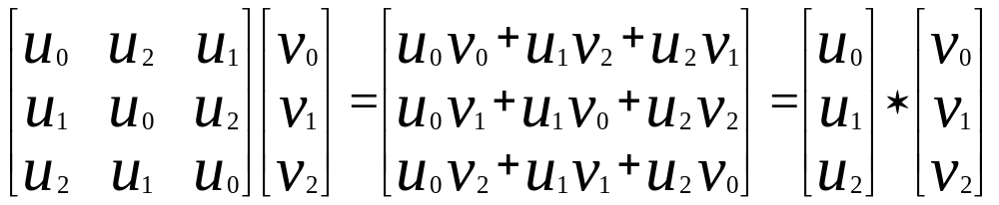
Circulant Matrices
Definition: A circulant matrix C(u₀,…,u_{n}) is obtained by cyclically rotating the vector u₀,…,u_{n}. Multiplication by a circulant matrix corresponds to cyclic convolution.
The (i,j) element of C(u₀,…,u_{n}) is equal to u_{i-j mod n}
Example

Slide 21
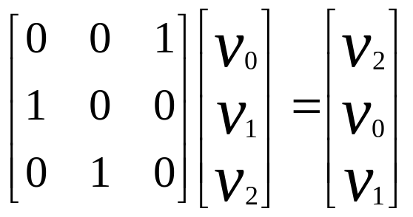
Shift Matrices
Definition: The n-point shift matrix S_{n} is the permutation matrix that cyclically shifts the elements of a vector.
The (i,j) element of S_{n} is equal to 1 when i-j ≡ 1 (mod n)
Example

Slide 22
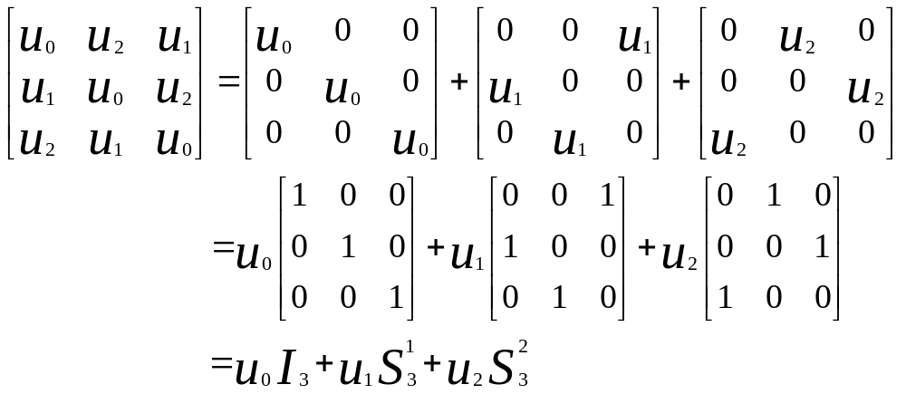
Generating Circulant Matrices
A circulant matrix is equal to a linear combination of powers of the shift matrix.

Slide 23
Convolution Theorem
Theorem: F_{n}(u * v) = F_{n}(u) • F_{n}(v)
u * v = F_{n}⁻¹(F_{n}(u) • F_{n}(v))
This theorem provides an O(nlogn) algorithm for performing cyclic convolution provided F_{n} is computed with the FFT.
We will prove this theorem two different ways
  Show that F_{n} diagonalizes a circulant matrix
  Use the Chinese remainder theorem

Slide 24
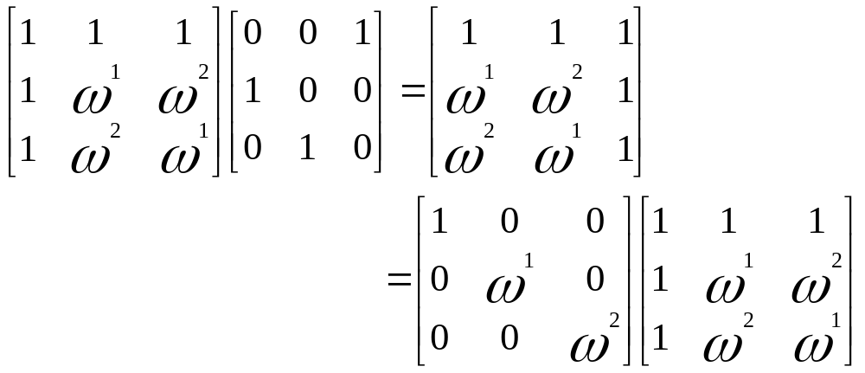
Diagonalizing the Shift Matrix
Theorem: F_{n} S_{n} = W_{n} F_{n}, where W_{n} = diag(1,ω,…, ω^{n-1})

Slide 25
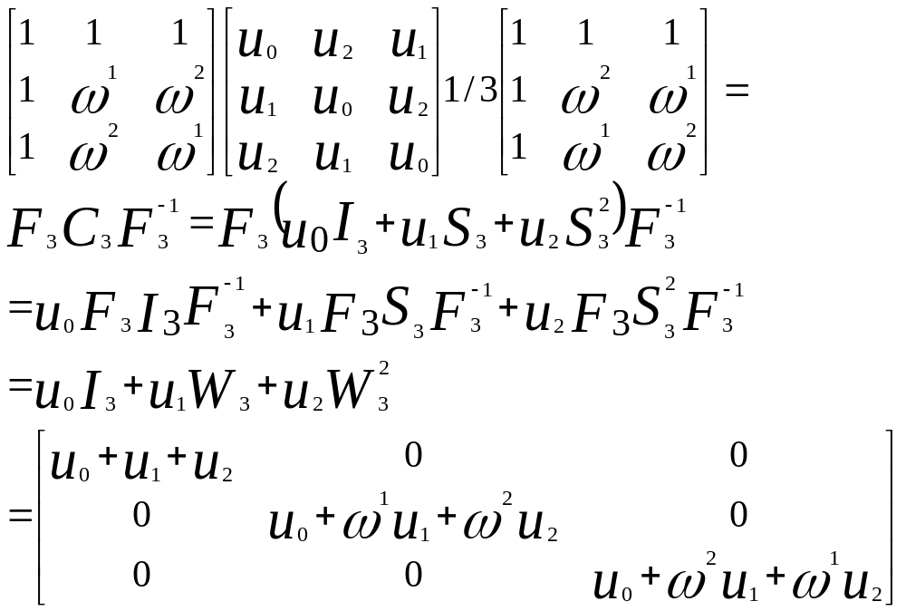
Diagonalizing a Circulant Matrix
Theorem: F_{n} C_{n}(u) = diag(F_{n}(u)) F_{n}

Slide 26
First Proof of the Convolution Theorem
Theorem: F_{n}(u * v) = F_{n}(u) • F_{n}(v)
u * v = F_{n}⁻¹(F_{n}(u) • F_{n}(v))
Proof:
F_{n}(u * v) = F_{n}(C(u) v)
= diag(F_{n}(u)) F_{n}v
= F_{n}(u) • F_{n}(v)

Slide 27
Polynomial Version of the Chinese Remainder Theorem
Theorem: Let f(x) and g(x) be polynomials in F[x] (coefficients in a field). Assume that gcd(f(x),g(x)) = 1. For any A₁(x) and A₂(x) there exist a polynomial A(x) with A(x) ≡ A₁(x) (mod f(x)) and A(x) ≡ A₂(x) (mod g(x)).
Theorem: F[x]/(f(x)g(x)) ≈ F[x]/(f(x)) × F[x]/(g(x)). I.E. There is a 1-1 mapping from F[x]/(f(x)g(x)) onto F[x]/(f(x)) × F[x]/(g(x)) that preserves arithmetic.
A(x) → (A(x) mod f(x), A(x) mod g(x))

Slide 28
Multifactor CRT
The CRT can be generalized to the case when we have n pairwise relatively prime polynomials. If f₁(x),…,f_{n}(x) are pairwise relatively prime, i.e. gcd(f_{i}(x),f_{j}(x)) = 1 for i ≠ j, then given A₁(x),…,A_{n}(x) there exists a polynomial A(x) such that A ≡ A_{i}(x) (mod f_{i}(x)).
Moreover, there exist a system of orthogonal idempotents: E₁(x),…,E_{n}(x), such that E_{i}(x) ≡ 1 (mod f_{i}(x)) and E_{i}(x) ≡ 0 (mod f_{j}(x)) for i ≠ j. A(x) = A₁(x)E₁(x) + … + A_{n}(x)E_{n}(x)
F[x]/(A₁(x)…A_{n}(x) ≈ F[x]/(A₁(x)) × … × F[x]/(A_{n}(x))

Slide 29
CRT and the Convolution Theorem
Since x^{n}-1 = (x-1)(x-ω)…(x-ω^{n-1}) and gcd(x-ω^{i}, x-ω^{j}) = 1 for i≠ j C[x]/(x^{n}-1) ≈ C[x]/(x-1) × … × C[x]/(x-ω^{n-1})
Let u(x) and v(x) be elements of C[x]/(x^{n}-1)
The map C[x]/(x^{n}-1) onto C[x]/(x-1) × … × C[x]/(x-ω^{n-1}) is F_{n}
  u(x) gets mapped to (u(1),…,u(ω^{n-1}))
Multiplication in C[x]/(x^{n}-1) is cyclic convolution
Multiplication in C[x]/(x-1) × … × C[x]/(x-ω^{n-1}) is a point-wise product
First multiplying u(x) and v(x) in C[x]/(x^{n}-1) and then applying F_{n} is the same as applying F_{n} to u(x) and F_{n} to v(x) and then multiplying in C[x]/(x-1) × … × C[x]/(x-ω^{n-1}).
Therefore, F_{n}(u * v) = F_{n}(u) • F_{n}(v)

Slide 30
CRT and the FFT
Factor F_{n} by projecting onto C[x]/(x-1) × … × C[x]/(x-ω^{n-1}) in stages
Let n = 2m, then x^{n}-1 = (x^{m}-1)(x^{m}+1) and gcd(x^{m}-1,x^{n}-1) = 1
C[x]/(x^{n}-1) ≈ C[x]/(x^{m}-1) × C[x]/(x^{m}+1)
  This mapping is F₂ ⊗ I_{m}
C[x]/(x^{m}-1) ≈ C[x]/(x-1) × C[x]/(x-ω²) × … × C[x]/(x-ω^{2(m-1)})
  This mapping is F_{m}
C[x]/(x^{m}+1) ≈ C[x]/(x-ω) × … × C[x]/(x-ω^{2m-1})
  This mapping is W_{m}F_{m}
(F_{m} ⊕ W_{m}F_{m})(F₂ ⊗ I_{m})
A(x) → (A(1),A(ω²⁾,…,A(ω^{2(m-1)}),A(ω),…,A(ω^{n-1)}))

Slide 31
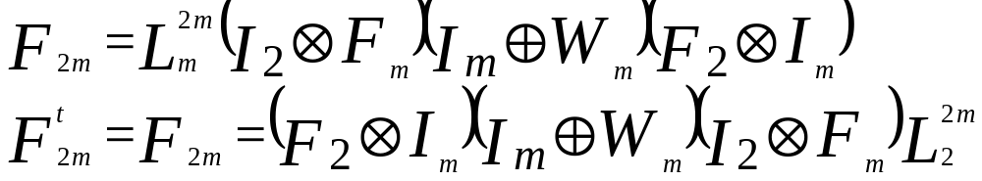
CRT and the FFT
(F_{m} ⊕ W_{m}F_{m})(F₂ ⊗ I_{m})
A(x) → (A(1),A(ω²⁾,…,A(ω^{2(m-1)}),A(ω),…,A(ω^{n-1)}))
F_{2m}
A(x) → (A(1), A(ω),A(ω²⁾,…,A(ω^{n-1)}))
Therefore,

